Slide 1
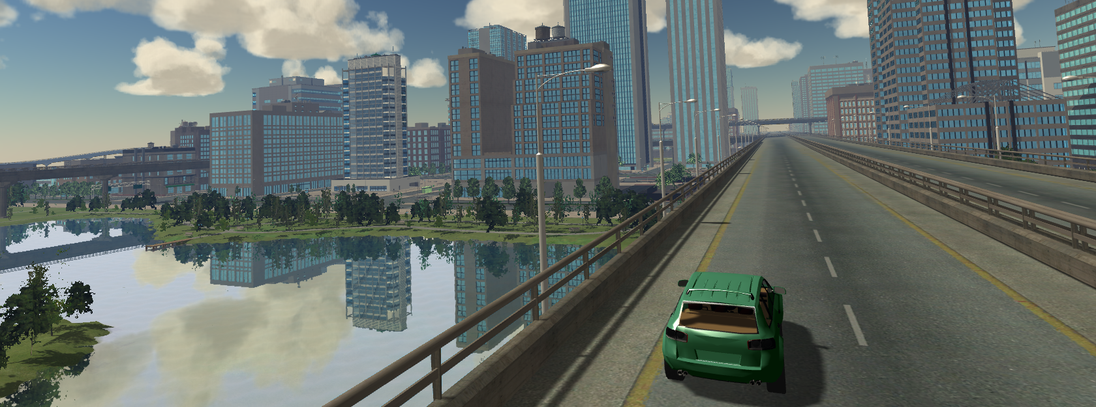
Application of Linear-Time Variational Integrators in Experimentible Digital Twins
B.Sc Yumin Xiong, 21.07.2025
Notes:
Good Afternoon, everyone. today I’m excited to present my master’s thesis titled “”

Slide 2
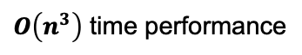
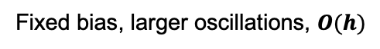
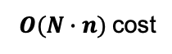
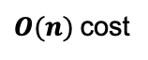
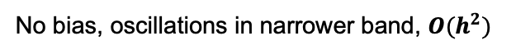
Contributions
Symplectic structure
First discretize Lagrangian, then apply Hamilton’s principle
Energy preservation
No bias, oscillations in narrower band, $O(h^{2})$
Mid point rule to discretize the Lagrangian
My mid-point VI
Linear time performance
Use graph representation and DFS to generate elimination ordering from leaf to root
Differentiable
DEL and Constraints equations are smooth
Differentiability
$O(n)$cost
Only one back-substitution
Newton solver provides Jacobian factorization
Fixed bias, larger oscillations, $O(h)$
Forward difference to discretize the Lagrangian
Other VIs
$O\left(n^{3}\right)$ time performance
Dense LDU factorization
Energy drift, or even instability
No symplectic structure
First write equation of motion, then discretize
Classical integrators
Differentiability
$O(N∙n)$cost
Reverse-mode differentiation through every time step $N$
Notes:
My mid-point VI:First one VI integrated into EDT
Other VIs: Used for testing, implemented in research environments such as Julia

Slide 3
Contents
Motivation
State of the Art
Methodology
Implementation
Validation
Conclusion

Slide 4
Motivation

Slide 5
Motivation
Three Critical Challenges:
Traditional numerical integrators often fail to preserve important physical invariants, leading to energy drift and unreliable long-term behavior.
The computational complexity of generic sparse solvers becomes interactable for robots with many degrees of freedom, limiting their application in complex systems.
The lack of build-in support for computing derivatives in many existing simulators restricts their use in modern optimization-based robotic workflows.
Notes:
Recently, there's been a growing interest in using structure-preserving integrators for learning and optimization in robotics.
But in practice, the integrators still face three main challenges:
preserving energy, staying efficient, and being differentiable.
In this work, I propose a framework that brings together energy preservation, linear-time performance, and built-in differentiability—all in one place.

Slide 6
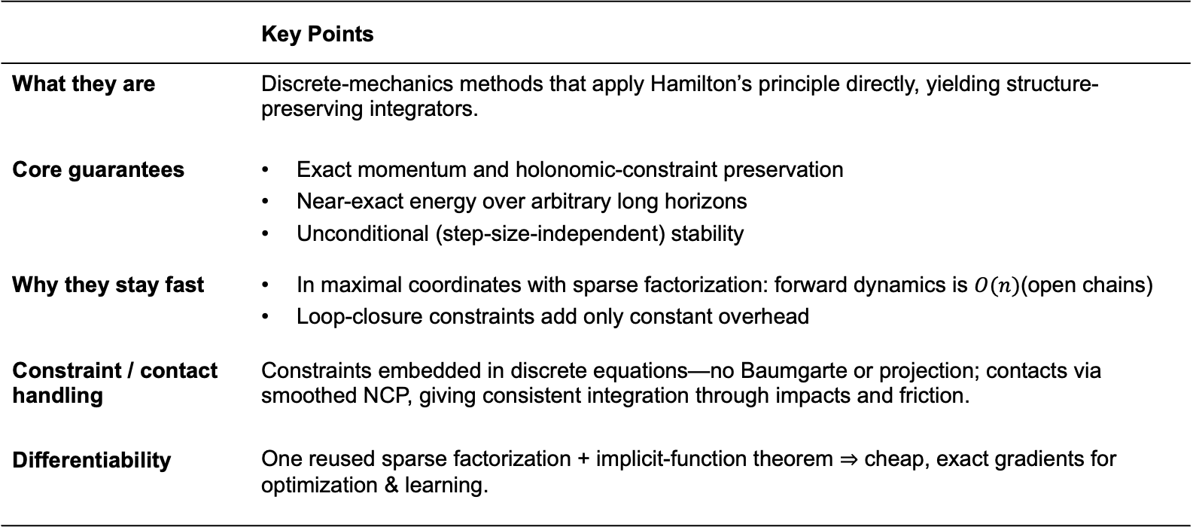
Motivation
Variational Integrator: The Right Fit for EDTs
 | Key Points
What they are | Discrete-mechanics methods that apply Hamilton’s principle directly, yielding structure-preserving integrators.
Core guarantees | Exact momentum and holonomic-constraint preservation Near-exact energy over arbitrary long horizons Unconditional (step-size-independent) stability
Why they stay fast | In maximal coordinates with sparse factorization: forward dynamics is $O(n)$(open chains) Loop-closure constraints add only constant overhead
Constraint / contact handling | Constraints embedded in discrete equations—no Baumgarte or projection; contacts via smoothed NCP, giving consistent integration through impacts and friction.
Differentiability | One reused sparse factorization + implicit-function theorem ⇒ cheap, exact gradients for optimization & learning.
Notes:
Now that we’ve discussed the challenges, let’s look at why variational integrators are such a good fit for experimentible digital twins.
Variational integrators apply Hamilton’s principle in discrete form.
They preserve physical structures like momentum and energy and stay stable regardless of time step size. In maximal coordinates, they support fast forward dynamics with linear-time complexity.
Constraints are built directly into the equations—no Baumgarte or projection is needed.
This makes them suitable for differentiable simulation, allowing cheap and accurate gradients.
这里的project和后面的project
My “projection to subspace” merely maps redundant rotation errors onto the active constraint basis inside the solver, not the post-step position projection the paper warns against.

Slide 7
State of the Art

Slide 8
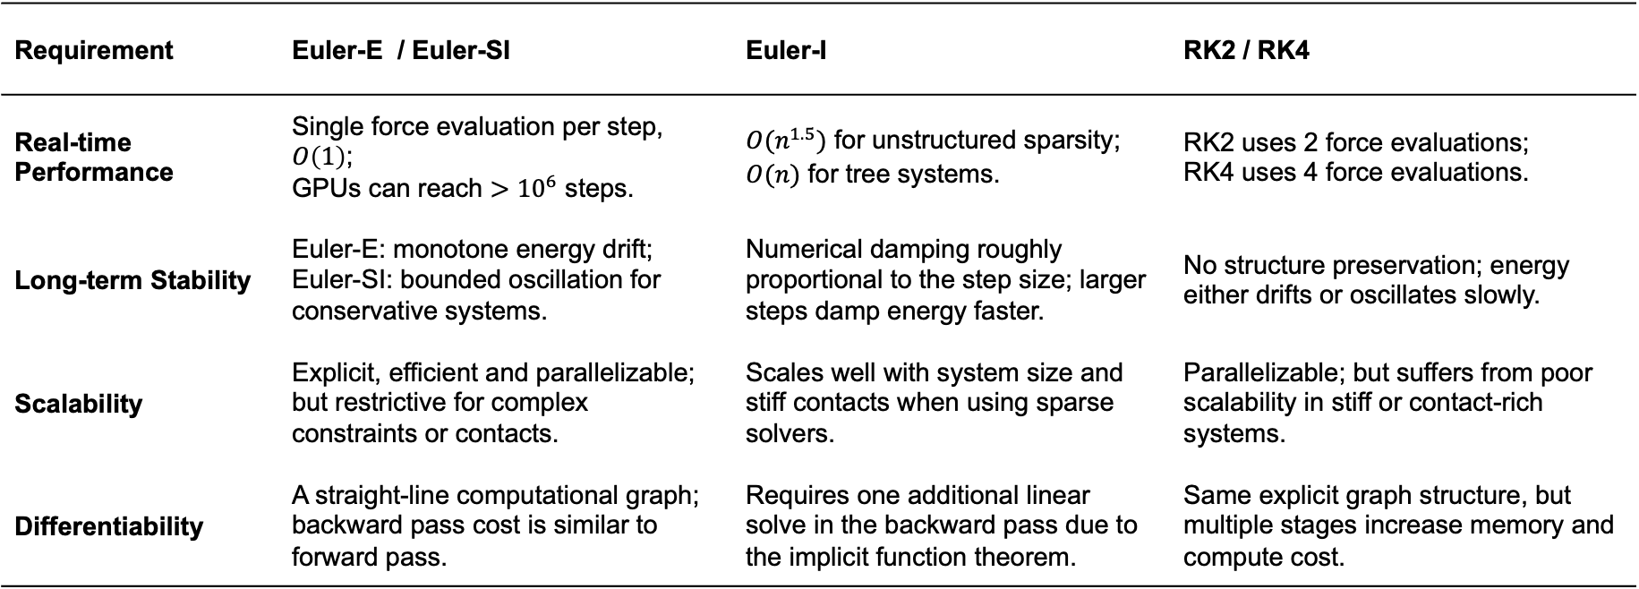
State of the Art
Limitations of Traditional Integrators
Note: Force evaluation refers to one computation of the right-hand side of the differential equation.
Requirement | Euler-E / Euler-SI | Euler-I | RK2 / RK4
Real-time Performance | Single force evaluation per step, $O\left(1\right)$; GPUs can reach $>{10}^{6}$ steps. | $O(n^{1.5})$ for unstructured sparsity; $O(n)$ for tree systems. | RK2 uses 2 force evaluations; RK4 uses 4 force evaluations.
Long-term Stability | Euler-E: monotone energy drift; Euler-SI: bounded oscillation for conservative systems. | Numerical damping roughly proportional to the step size; larger steps damp energy faster. | No structure preservation; energy either drifts or oscillates slowly.
Scalability | Explicit, efficient and parallelizable; but restrictive for complex constraints or contacts. | Scales well with system size and stiff contacts when using sparse solvers. | Parallelizable; but suffers from poor scalability in stiff or contact-rich systems.
Differentiability | A straight-line computational graph; backward pass cost is similar to forward pass. | Requires one additional linear solve in the backward pass due to the implicit function theorem. | Same explicit graph structure, but multiple stages increase memory and compute cost.
Notes:
This table compares traditional integrators Euler explicit/Euler semi-implicit Euler implicit and Runge Kutta 2 and Runge Kutta 4 on four key aspects.
Each of these methods has its own advantage—some are fast, some are simple, and some are accurate—but none of them can satisfy all three challenges we mentioned earlier.
preserving energy, staying efficient, and being differentiable
That’s why I need to implement a variational integrator

Slide 9
Methodology

Slide 10
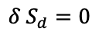
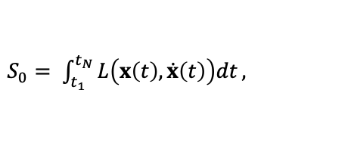
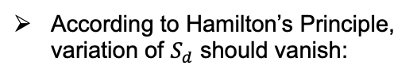
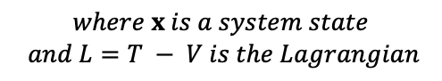
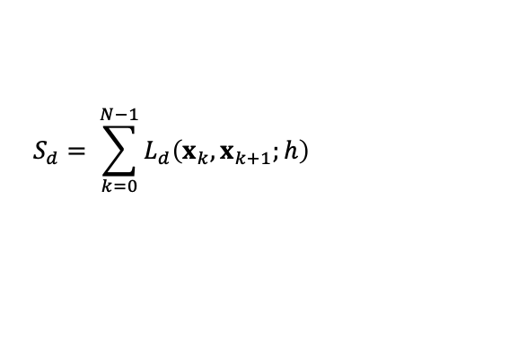
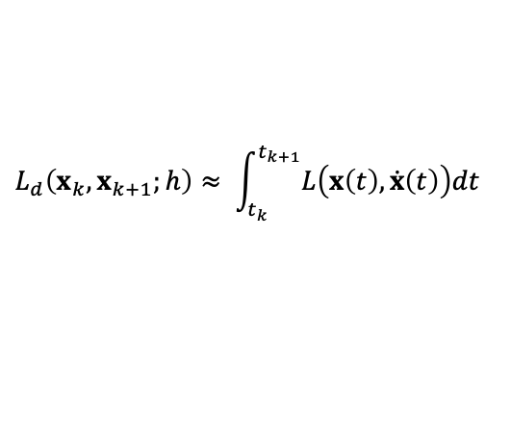
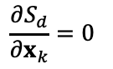
Methodology
Principle of stationary action
Continuous action integral:
Discrete action integral:
Discrete Lagrangian
$$S_{d}= \sum_{k=0}^{N−1}{L_{d}\left(x_{k},x_{k+1};h\right)}$$
$S_{0}= \int_{t_{1}}^{t_{N}}{L\left(x\left(t\right),\dot{x}\left(t\right)\right)dt},$
$$L_{d}\left(x_{k},x_{k+1};h\right)≈ \int_{t_{k}}^{t_{k+1}}{L\left(x\left(t\right),\dot{x}\left(t\right)\right)dt}$$
$$where x is a system state$$
$$and L=T − V is the Lagrangian$$
According to Hamilton’s Principle, variation of $S_{d}$ should vanish:
Partial derivatives with respect to discrete path variables:
Mathematically equivalent
$$\frac{∂S_{d}}{∂x_{k}}=0$$
$$δ S_{d}=0$$
Notes:
Let start with Hamilton’ principle
Hamilton’s Principle states that the true motion of a system makes the action integral stationary, which means the the first derivative with respect to any admissible path variation is zero.
We approximate discrete Lagrangian to get discrete action integral from continuous action integral
To satisfy Hamilton’s Principle, the variation of this discrete action must vanish.
which mathematically equivalent to the partial derivatives of the discrete action with respect to each position must be zero.

Slide 11
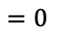
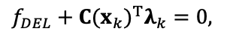
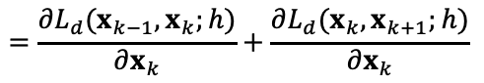
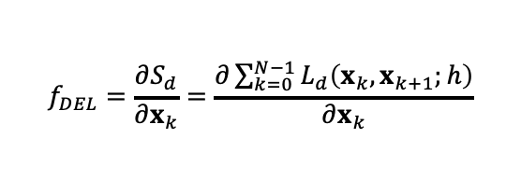
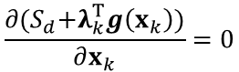
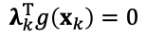
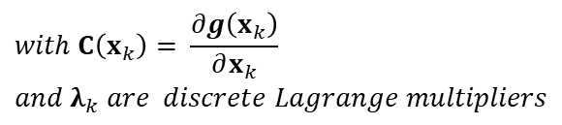
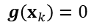
Methodology
Discrete Euler-Lagrange (DEL) equations
DEL equations:
DEL equations with constraints:
$$\frac{∂{(S}_{d}+λ_{k}^{T}g\left(x_{k}\right))}{∂x_{k}}=0$$
$$f_{DEL}=\frac{∂S_{d}}{∂x_{k}}=\frac{∂\sum_{k=0}^{N−1}{L_{d}\left(x_{k},x_{k+1};h\right)}}{∂x_{k}}$$
$$=\frac{∂L_{d}(x_{k−1},x_{k};h)}{∂x_{k}}+\frac{∂L_{d}(x_{k},x_{k+1};h)}{∂x_{k}}$$
Position-level constraints
$$g\left(x_{k}\right)=0$$
$$f_{DEL}+{C(x_{k})}^{T}λ_{k}=0,$$
Virtual work
$$λ_{k}^{T}g\left(x_{k}\right)=0$$
$$with C\left(x_{k}\right)= \frac{∂g\left(x_{k}\right)}{∂x_{k}}$$
$$and λ_{k} are discrete Lagrange multipliers$$
$${{=D}_{2}L}_{d}\left(x_{k−1},x_{k};h\right)+D_{1}L_{d}\left(x_{k},x_{k+1};h\right)$$
$$=0$$
Interpreted as discrete equation of motion
Notes:
So we need to take the partial derivatives with respect to the discrete state xkx​, we get the discrete Euler–Lagrange equations, shown on the left.
To include holonomic constraints， we add position-level constraint functions g(xk)=0 by summing the discrete action integral with the virtual work
Then we get the constrained DEL equations contains position Jacobian
This equation can be interpreted as the discrete equation of motion.
为什么用位置层？能不能用速度层？
Because we have only holonomic equality constraints, enforcing them at the position level is best, as it prevents drift and keeps the variational integrator’s geometric structure intact.
Although they could be enforced at the velocity level, that would introduce drift and weaken long-term structure preservation, so we impose them at the position level instead.

Slide 12
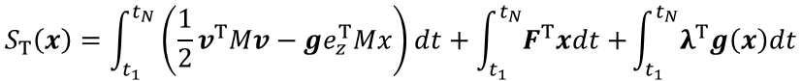
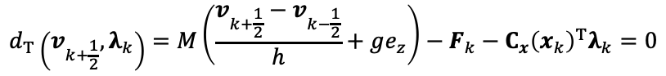
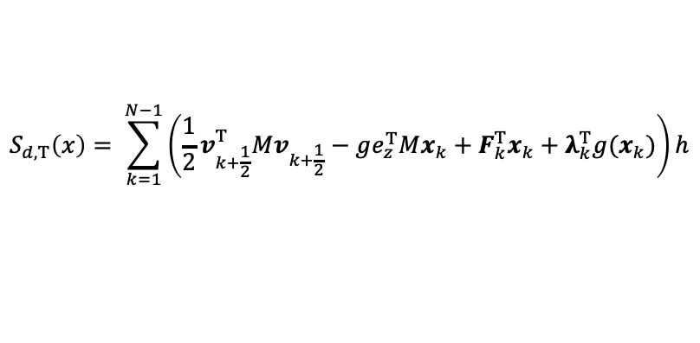
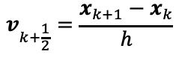
Methodology
Translational Part of Discrete Euler-Lagrange (DEL) equations
Forced and constrained action integral
$$S_{T}\left(x\right)=\int_{t_{1}}^{t_{N}}{\left(\frac{1}{2}v^{T}Mv−ge_{z}^{T}Mx\right)dt+\int_{t_{1}}^{t_{N}}{F^{T}xdt+}\int_{t_{1}}^{t_{N}}{λ^{T}g\left(x\right)dt}}$$
Midpoint Rule approximation
$$v_{k+\frac{1}{2}}=\frac{x_{k+1}−x_{k}}{h}$$
$$S_{d,T}\left(x\right)= \sum_{k=1}^{N−1}{\left(\frac{1}{2}v_{k+\frac{1}{2}}^{T}Mv_{k+\frac{1}{2}}−ge_{z}^{T}Mx_{k}+F_{k}^{T}x_{k}+λ_{k}^{T}g(x_{k})\right)h}$$
Discrete action integral
Partial derivative
$$∇_{x_{k}}S_{d,T}\left(x_{k}\right)=\left(\frac{1}{h}Mv_{k−\frac{1}{2}}−\frac{1}{h}Mv_{k+\frac{1}{2}}−gMe_{z}+F_{k}+C_{x}{\left(x_{k}\right)}^{T}λ_{k}\right)h=0$$
Discretized translational equation of motion
$$d_{T}\left(v_{k+\frac{1}{2}},λ_{k}\right)=M\left(\frac{v_{k+\frac{1}{2}}−v_{k−\frac{1}{2}}}{h}+ge_{z}\right)−F_{k}−C_{x}{\left(x_{k}\right)}^{T}λ_{k}=0$$
Notes:
In the next two slides, we break down the DEL equations into translational and rotational parts for separate computation. we get the discretized translational equation of motion dT,
Note here, we use midpoint rule to discretize the continuous action integral
So dt is a function of vk+1/2, not of xk
Due to time limits, I won’t go into the full derivation here.
v k plus one half
为什么用中点法
Because the midpoint discretization is time-symmetric and second-order accurate, it preserves the variational/symplectic structure and yields far more reliable long-term dynamics than forward or backward differences.

Slide 13
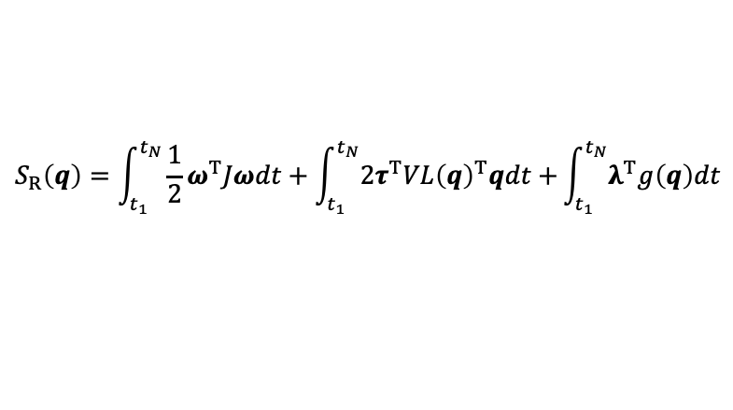
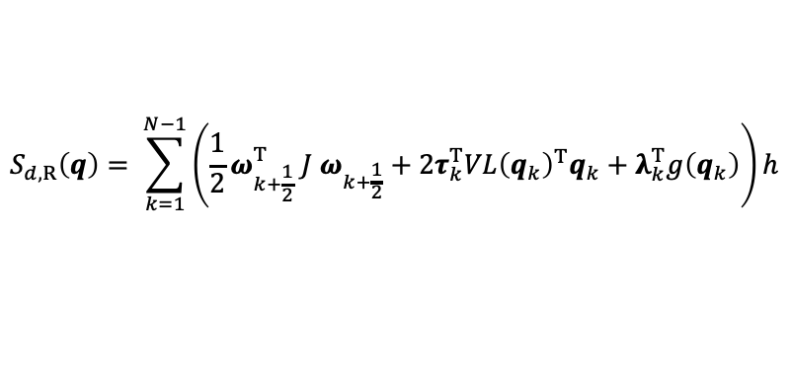
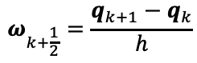
Methodology
Rotational Part of Discrete Euler-Lagrange (DEL) equations
Forced and constrained action integral
$$S_{R}\left(q\right)=\int_{t_{1}}^{t_{N}}{\frac{1}{2}ω^{T}Jωdt+\int_{t_{1}}^{t_{N}}{2τ^{T}VL{\left(q\right)}^{T}qdt+}\int_{t_{1}}^{t_{N}}{λ^{T}g\left(q\right)dt}}$$
Midpoint Rule approximation
$$ω_{k+\frac{1}{2}}=\frac{q_{k+1}−q_{k}}{h}$$
$$S_{d,R}\left(q\right)= \sum_{k=1}^{N−1}{\left(\frac{1}{2}ω_{k+\frac{1}{2}}^{T} J ω_{k+\frac{1}{2}}+2τ_{k}^{T}VL{\left(q_{k}\right)}^{T}q_{k}+λ_{k}^{T}g\left(q_{k}\right)\right)h}$$
Discrete action integral
Partial derivative
$$∇_{q_{k}}^{r}S_{d,R}\left(q\right)=VL{\left(q_{k}\right)}^{T}∇_{q_{k}}S_{d,R}\left(q\right)=0$$
Discretized rotational equation of motion
$$d_{R}\left(ω_{k+\frac{1}{2}},λ_{k}\right)=J ω_{k+\frac{1}{2}}\sqrt{\frac{4}{h^{2}}−ω_{k+\frac{1}{2}}^{T}ω_{k+\frac{1}{2}}}+ω_{k+\frac{1}{2}}^{×}Jω_{k+\frac{1}{2}}−Jω_{k−\frac{1}{2}}\sqrt{\frac{4}{h^{2}}−ω_{k−\frac{1}{2}}^{T}ω_{k−\frac{1}{2}}}−ω_{k−\frac{1}{2}}^{×}Jω_{k−\frac{1}{2}}−2τ_{k}−C_{q}{\left(q_{k}\right)}^{T}λ_{k}=0$$
Notes:
And Here, we get the discretized rotational equation of motion dR

Slide 14

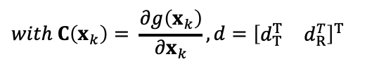
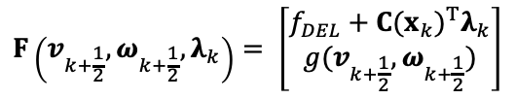
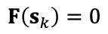
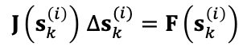
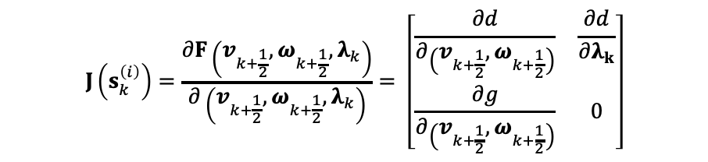
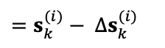
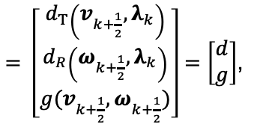
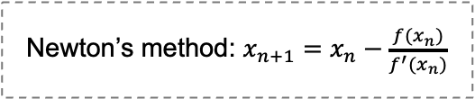
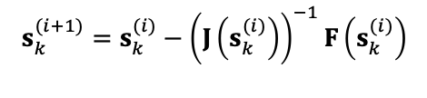
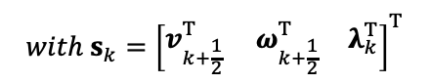
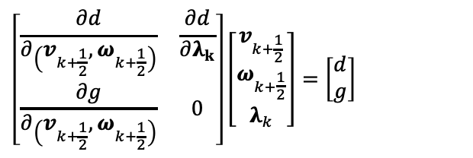
Methodology
Nonlinear System and Newton’s Method
Newton’s method: $x_{n+1}=x_{n}−\frac{f(x_{n})}{f^{′}(x_{n})}$
Assemble System Equation:
To use Newton’s method, we need Jacobian of $F$:
$$J\left(s_{k}^{\left(i\right)}\right)=\frac{∂F\left(v_{k+\frac{1}{2}},ω_{k+\frac{1}{2}},λ_{k}\right)}{∂\left(v_{k+\frac{1}{2}},ω_{k+\frac{1}{2}},λ_{k}\right)}= \left[\begin{matrix}\frac{∂d}{∂\left(v_{k+\frac{1}{2}},ω_{k+\frac{1}{2}}\right)} & \frac{∂d}{∂λ_{k}} \\ \frac{∂g}{∂\left(v_{k+\frac{1}{2}},ω_{k+\frac{1}{2}}\right)} & 0\end{matrix}\right]$$
$$F\left(v_{k+\frac{1}{2}},ω_{k+\frac{1}{2}},λ_{k}\right)= \left[\begin{matrix}f_{DEL}+{C(x_{k})}^{T}λ_{k} \\ g(v_{k+\frac{1}{2}},ω_{k+\frac{1}{2}})\end{matrix}\right]$$
$= \left[\begin{matrix}d_{T}\left(v_{k+\frac{1}{2}},λ_{k}\right) \\ d_{R}\left(ω_{k+\frac{1}{2}},λ_{k}\right) \\ g(v_{k+\frac{1}{2}},ω_{k+\frac{1}{2}})\end{matrix}\right]=\left[\begin{matrix}d \\ g\end{matrix}\right]$,
Newton’s method solves implicit equation:
$$s_{k}^{(i+1)}=s_{k}^{(i)}−{\left(J\left(s_{k}^{(i)}\right)\right)}^{−1}F\left(s_{k}^{(i)}\right)$$
$$=s_{k}^{(i)}− ∆s_{k}^{(i)}$$
$$with C\left(x_{k}\right)= \frac{∂g\left(x_{k}\right)}{∂x_{k}},d={\left[\begin{matrix}d_{T}^{T} & d_{R}^{T}\end{matrix}\right]}^{T}$$
Linearize around the current iterate:
Non-linear Equation:
$$\left[\begin{matrix}\frac{∂d}{∂\left(v_{k+\frac{1}{2}},ω_{k+\frac{1}{2}}\right)} & \frac{∂d}{∂λ_{k}} \\ \frac{∂g}{∂\left(v_{k+\frac{1}{2}},ω_{k+\frac{1}{2}}\right)} & 0\end{matrix}\right]\left[\begin{matrix}v_{k+\frac{1}{2}} \\ ω_{k+\frac{1}{2}} \\ λ_{k}\end{matrix}\right]=\left[\begin{matrix}d \\ g\end{matrix}\right]$$
$${with s}_{k}={\left[\begin{matrix}v_{k+\frac{1}{2}}^{T}{ ω}_{k+\frac{1}{2}}^{T} & λ_{k}^{T}\end{matrix}\right]}^{T}$$
$$F\left(s_{k}\right)=0$$
$J\left(s_{k}^{\left(i\right)}\right)$ $∆s_{k}^{(i)}=F\left(s_{k}^{\left(i\right)}\right)$
Solve this equation to find the solution $s_{k}$with Newton’s method
Notes:
And here we assemble previously derived equation dt and dr with constraints.
Similarly, the constraints here are also expressed using midpoint linear and angular velocities.
This gives us a nonlinear system F(sk)=0, where sk includes velocity, angular velocity, and Lagrange multipliers.
We apply Newton’s method, which requires the Jacobian matrix of the system.
as shown on the upper right
It’s worth noting that the bottom-left block is the derivative of the constraints with respect to velocity, and the top-right , the derivate of del with respect to lambda is the position Jacobian of the constraints
At each iteration, we linearize the system and solve for the update Δs.
为什么选牛顿
I pick Newton’s method because it keeps the system symplectic and hits high accuracy in just a few steps, so it’s the standard solver for discrete Euler–Lagrange equations in implicit VI.

Slide 15
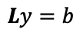

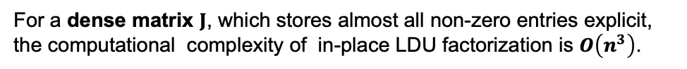
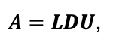

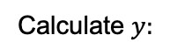
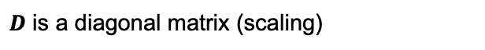
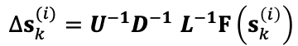

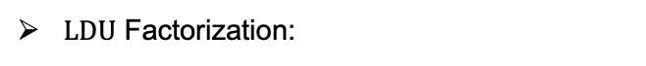
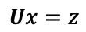
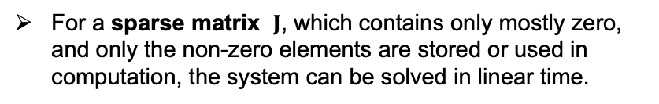





Methodology
Dense $LDU$ Decomposition
Solving $Ax=b$ using $LDU$ Decomposition:
To solve our problem:
Step 1: Factorization
$J\left(s_{k}^{\left(i\right)}\right)$ $∆s_{k}^{(i)}=F\left(s_{k}^{\left(i\right)}\right)$
Decompose the matrix $A$ as:
$A=LDU$,
$LDU$ Factorization:
where:
$$J\left(s_{k}^{\left(i\right)}\right)=LDU$$
$L$ is a lower triangular matrix with unit diagonal
For a dense matrix $J$, which stores almost all non-zero entries explicit, the computational complexity of in-place LDU factorization is $O\left(n^{3}\right)$.
$D$ is a diagonal matrix (scaling)
$U$ is an upper triangular matrix with unit diagonal
Step 2: Forward substitution
$LDU$ Back-Substitution:
Calculate $y:$
$∆s_{k}^{(i)}=U^{−1}D^{−1}$ $L^{−1}F\left(s_{k}^{\left(i\right)}\right)$
$$Ly=b$$
The computational complexity of in-place LDU back-substitution is $O\left(n^{2}\right)$.
Step 3: Diagonal scaling
Calculate $z:$
For a sparse matrix $J$, which contains only mostly zero, and only the non-zero elements are stored or used in computation, the system can be solved in linear time.
$$Dz=y$$
Step 4: Backward substitution
Calculate $x:$
$$Ux=z$$
Notes:
This slide explains how we solve this linear system
We use LDU decomposition
On the left, outline the standard four steps
On the right, we show how this applies to our Jacobian J
Decompse J into LDU
For dense
Big O of n cubed, squared
However, and this is the key point, for a sparse matrix,
We only need to store and compue on the non-zero entries.
This allow us to solve the system in linear time .

Slide 16








Methodology
Sparse $LDU$ Decomposition
(a)
Unordered matrix causes fill-ins during $LDU$ factorization, turning the following steps into a dense $LDU$.
Reorder the matrix using a Depth-First Search traversal
(b)
Rearranged matrix avoids fill-ins during $LDU$ factorization, keeping the following steps in sparse $LDU$
Rectangular nodes: rigid bodies
Circular nodes: joints
$D_{1}$ to $D_{5}$: diagonal blocks for the five rigid bodies
$D_{6}$ to $D_{9}:$diagonal blocks for the four joints.
$c_{ij}$： represents the position Jacobian blocks
$c_{ij}^{′}$： represents the velocity Jacobian blocks.
Notes:
Now we come to the key idea that enables linear-time performance
On the left, we use a graph representation of the machanical system
On the right, we can see the matrix form of it.
for unordered matrix, it will create fill-ins during LDU factorization, you can see in matrix (a), the balck dots indicate the fill in
for reordered matrix, it will avoid fill-ins during LDU factorization, keeping the following steps in sparse LDU,
So we reorder the matrix using a dfs, we can solve the equation derived before in linear time
为什么用dfs，
use a depth-first search (DFS) ordering, the leaf-to-root elimination guarantees zero fill-in, and costs only O(n) to compute
Other method such as minimum-degree can be applied, but less appropriate for this particular structure.

Slide 17






Methodology
Sparse $LDU$ Decomposition
Dense $LDU$
Sparse $LDU$
triple nested loop
constant number of neighbors
constant number of neighbors
double nested loop
Linear-Time Computational Complexity!
Notes:
This slide shows where the saving come from
On the left, we see the dense implementaion
The in-place factorizaition involves a triple nestes loop, giving O(n^3) complexity
The back-substitution step has a double nested loop, giving O(n^2) complexity
for our sparse ldu
Each node only interact with constant number of neighbors.
As a result, both the factorization and back-substitution become linear in system size.

Slide 18
Implementation

Slide 19









Implementation
States and Newton’s Method
Converged midpoint states at last time step:
$x_{c}, q_{c},v_{c},w_{c}= x_{k−\frac{1}{2}},q_{k−\frac{1}{2}}$, $v_{k−\frac{1}{2}}$, $w_{k−\frac{1}{2}}$
In each Newton Iteration:
Use candidate midpoint states $v_{sol},w_{sol}$ in last iteration and $v_{c},w_{c}$ to calculate the residual of the discretized equations of motion $d_{T}\left(v_{k+\frac{1}{2}},λ_{k}\right)$, $d_{R}\left(ω_{k+\frac{1}{2}},λ_{k}\right)$ and Jacobian of them.
Discrete knot-points states:
$x_{k},q_{k}$
Candidate midpoint states in each Newton interation:
$v_{sol},w_{sol}=v_{k+\frac{1}{2}},w_{k+\frac{1}{2}}$,${ x}_{sol}, q_{sol}=x_{k+\frac{1}{2}},q_{k+\frac{1}{2}}$
Then, use $x_{k},q_{k}$ and $v_{sol},w_{sol}$ to calculate the $k+1$discrete state $x_{k+1},q_{k+1}$ using the time integration and use them to calculate the residual of constraints $g(v_{k+\frac{1}{2}},ω_{k+\frac{1}{2}})$ and Jacobian of them.
Time Integration :
Assemble above residuals and Jacobians into system matrix, and solve it to get new candidate midpoint states $v_{sol},w_{sol}$ and $x_{sol},q_{sol}$.
$$x_{k+1}=x_{k}+∆tv_{k+\frac{1}{2}}$$
$$q_{k+1}=\frac{Δt}{2}L(q_{k})\left[\begin{matrix}\sqrt{{\left(\frac{2}{∆t}\right)}^{2}−ω_{k+\frac{1}{2}}^{T}ω_{k+\frac{1}{2}}} \\ ω_{k+\frac{1}{2}}\end{matrix}\right]$$
If new $v_{sol},w_{sol}$ and $x_{sol},q_{sol}$ meets the condition (the norm of residuals and update $∆s$), save the $v_{sol},w_{sol}$ into $x_{c}, q_{c},v_{c},w_{c}$. And update the $x_{k},q_{k}$. Stop Newton’s method.
Notes:
“This slide explains how the state variables are organized and how they are updated.
On the left, we show the three types of states:
We also show the time integration formulas. Compute the next position and orientation using midpoint velocity and angular velocity
On the right, outline the newton update loop
Use candidate midpoint state and converge midpoints state to calculate the motion residual and Jacobian
Use discrete point and candidate midpoint state to calculate the constraint residual and Jacobian of them
Next assemble them into system matrix and use LDU decomposition to solve the equation and get the new state
If new states meet the condition , save them and end the newton iteration.

Slide 20

















Implementation
Position-constraints in VI
$$\text{Equality} \text{Constraint}=\text{TranslationalConstraint}\text{ (0−3) +} \text{RotationalConstraint}\text{ (0−3)}$$
$$Revolute Joint = T3+ R2$$
$$Prismatic Joint = T2+R3$$
$T3：$
$$g_{T3}=q_{A_{k+1}}^{−1}[\left(x_{B_{k+1}}+q_{B_{k+1}}p_{B}\right)−\left(x_{A_{k+1}}+q_{A_{k+1}}p_{A}\right)]∈ℝ^{3×1}$$
$$Ball Joint = T3+R0$$
$Rigid Joint:g$
$R3：$
$$g_{R3}= q_{A_{k+1}}^{−1}q_{B_{k+1}}q_{offset}∈ℝ^{3×1}$$
$$Rigid Joint = T3+R3$$
$$g=\left[\begin{matrix}g_{T3} \\ g_{R3}\end{matrix}\right]∈ℝ^{6×1}$$
$T3$
$R2：$
$$g_{R2}={C_{rot}g}_{R3}$$
$with C_{rot}=\left[\begin{matrix}1 & 0 & 0 \\ 0 & 1 & 0\end{matrix}\right] (for a revolute axis along e_{z})$
$Revolute Joint:g$
$$g=\left[\begin{matrix}g_{T3} \\ g_{R2}\end{matrix}\right]∈ℝ^{5×1}$$
Note, here $v_{k+\frac{1}{2}}$ is $v_{sol}$ at current Newton iteration
$L\left(q\right):$ Left quaternion multiplication matrix that applies the rotation $q$to another quaternion.
$p_{A/B}$: Joint’s anchor expressed in Body A/B
$q_{offset}:$ The fixed reference orientation between Body A and B
$C_{rot}:$ Projection matrix
Notes:
Since VEROSIM uses the JMᵀJ approach based on velocity constraints, and my approach relies on position-level constraints,
I had to construct my own equality constraints
Note that the number here indicates how many DOF we constrain, not how many are available.
The key ides is that we first compute the full translational part (T3) and the rotational part (R3).
Then project t3 or r3 onto the subspace
As you can see, the constrains for revolute joint, you need to project the full rotational part into the R2 and then stack with the full translational part
The same approach is applied to other joint constraints as well

Slide 21









Implementation
The Position Jacobian of the Constraints
$x_{A},q_{A},x_{B},q_{B}$ all at time $k+1$
$$C{\left(x_{A},q_{A},x_{B},q_{B}\right)}_{T3}=\frac{∂g_{T3}}{∂\left(x_{A},q_{A},x_{B},q_{B}\right)}= \left[\begin{matrix}\begin{matrix}\frac{∂g_{T3}}{∂x_{A}} & \frac{∂g_{T3}}{∂q_{A}}\end{matrix} & \begin{matrix}\frac{∂g_{T3}}{∂x_{B}} & \frac{∂g_{T3}}{∂q_{B}}\end{matrix}\end{matrix}\right]∈ℝ^{3×12}$$
$$C{\left(x_{A},q_{A},x_{B},q_{B}\right)}_{R3}=\frac{∂g_{R3}}{∂\left(x_{A},q_{A},x_{B},q_{B}\right)}= \left[\begin{matrix}\begin{matrix}\frac{∂g_{R3}}{∂x_{A}} & \frac{∂g_{R3}}{∂q_{A}}\end{matrix} & \begin{matrix}\frac{∂g_{R3}}{∂x_{B}} & \frac{∂g_{R3}}{∂q_{B}}\end{matrix}\end{matrix}\right]∈ℝ^{3×12}$$
$Position Jacobian of Rigid Joint:C$
$$C=\left[\begin{matrix}C_{T3} \\ C_{R3}\end{matrix}\right]∈ℝ^{6×12}$$
$$J\left(s_{k}^{\left(i\right)}\right)=\left[\begin{matrix}\frac{∂d}{∂\left(v_{k+\frac{1}{2}},ω_{k+\frac{1}{2}}\right)} & \frac{∂d}{∂λ_{k}} \\ \frac{∂g}{∂\left(v_{k+\frac{1}{2}},ω_{k+\frac{1}{2}}\right)} & 0\end{matrix}\right]$$
Recall:
$C{\left(x_{A},q_{A},x_{B},q_{B}\right)}_{R2}=C_{rot}$ $C{\left(x_{A},q_{A},x_{B},q_{B}\right)}_{R3}$ $∈ℝ^{2×12}$
$Position Jacobian of Revolute Joint:C$
$$C=\left[\begin{matrix}C_{T3} \\ C_{R2}\end{matrix}\right]∈ℝ^{5×12}$$
Note: $\frac{∂g_{T3}}{∂q_{A}}$ $∈ℝ^{3×4}$
$LV^{T}\left(q_{A}\right)∈ℝ^{4×3},\frac{∂g_{T3}}{∂q_{A}}LV^{T}\left(q_{A}\right)$ $∈ℝ^{3×3}$
$L_{V}^{T}\left(q_{A}\right)$ is used to project the quaternion differential into 3D rotation space.
Notes:
And here we need to compute the Position Jacobian of the constraints
Let’s recall: when we introduced constraints into the DEL equations, we added virtual work and took its derivative with respect to discrete path variabel.
That’s why we need the position Jacobian here.
The same projection strategy is used here, compute the full translational or rotational part and then project to the subspace.

Slide 22









Implementation
The Velocity Jacobian of the Constraints
$$x_{A_{k+1}}=x_{A_{k}}+∆tv_{A_{k+\frac{1}{2}}}$$
Use the chain rule to calculate the velocity Jacobian from the position Jacobian
$$\frac{∂x_{A_{k+1} }}{∂{v_{A}}_{k+\frac{1}{2}}}=∆t$$
Translational Part Velocity Jacobian with respect to Body A:
$\frac{∂g_{T3_{k+1}}}{∂\left(v_{A_{k+\frac{1}{2}}},{ω_{A}}_{k+\frac{1}{2}} \right)}$ = $\frac{∂{g_{T3}}_{k+1}}{∂\left({x_{A}}_{k+\frac{1}{2}},{q_{A}}_{k+\frac{1}{2}} \right)}\frac{∂\left({x_{A}}_{k+\frac{1}{2}},{q_{A}}_{k+\frac{1}{2}} \right)}{∂\left({v_{A}}_{k+\frac{1}{2}},{ω_{A}}_{k+\frac{1}{2}}\right)}$
$\frac{∂{g_{T3}}_{k+1}}{∂{v_{A}}_{k+\frac{1}{2}}}=\frac{∂{g_{T3}}_{k+1}}{∂x_{A_{k+1} }}\frac{∂x_{A_{k+1} }}{∂{v_{A}}_{k+\frac{1}{2}}}=\frac{∂g_{T3}}{∂x_{A_{k+1} }}$ $∆t$
Recall:
$$J\left(s_{k}^{\left(i\right)}\right)=\left[\begin{matrix}\frac{∂d}{∂\left(v_{k+\frac{1}{2}},ω_{k+\frac{1}{2}}\right)} & \frac{∂d}{∂λ_{k}} \\ \frac{∂g}{∂\left(v_{k+\frac{1}{2}},ω_{k+\frac{1}{2}}\right)} & 0\end{matrix}\right]$$
$\frac{∂{g_{T3}}_{k+1}}{∂{ω_{A}}_{k+\frac{1}{2}}}=$ $\frac{∂{g_{T3}}_{k+1}}{∂{q_{A}}_{k+\frac{1}{2}}}L\left({q_{A}}_{k+\frac{1}{2}}\right)\overline{dω} \text{(}{ω_{A}}_{k+\frac{1}{2}}\text{,}∆t\text{)}\frac{∆t}{2}$,
$$with \overline{dω} \text{(}{ω_{A}}_{k+\frac{1}{2}}\text{,}∆t\text{)}\text{=}\left[\begin{matrix}−\frac{ω^{T}}{\sqrt{{\left(\frac{2}{∆t}\right)}^{2}−{ω_{A}}_{k+\frac{1}{2}}^{T}{ω_{A}}_{k+\frac{1}{2}}}} \\ I_{3}\end{matrix}\right]$$
$L\left({q_{A}}_{k+\frac{1}{2}}\right)：$ Left quaternion multiplication matrix that applies the rotation ${q_{A}}_{k+\frac{1}{2}}$to another quaternion.
$\overline{dω}\text{(}{ω_{A}}_{k+\frac{1}{2}}\text{,}∆t\text{):}$ This function computes the Jacobian of a quaternion increment with respect to angular velocity, assuming small-angle integration over a time step.
Notes:
And as you can see, since our solution of Newton solver includes velocity, angular velocity, and λ, the Jacobian must include derivatives with respect to those velocity terms.
So, we need to compute the Velocity Jacobian of the Constraints
Here, I use chain rule to calculate the velocity Jacobian from the position Jacobian,
Because the full Jacobian expression is quit long, I only show here the translational part of the Jacobian with respect to body a

Slide 23


Implementation
Simulate Process
Update state from $k$ to $k+1$
Notes:
This slide summarizes the entire simulation pipeline for one time step.
Start from the Simulate Scene and calls Perform Integration, which then triggers a single Integrate step
In this step, we enter the vi-newton solver, shown on the right.
Inside the solver, we initialize the counter and check whether the iteration number exceeds the threshold
If not, go through the newton loop,
Based on the current residual and increment delta s, we check convergence,
If converge, we exit the loop and update the state and convert to VEROSIM states.
If not, increase the counter and repeat,

Slide 24




Implementation
Interface
Automatically
Click Newton-Raphson
Lock Variational Integrator
Automatically
Lock Newton-Raphson
Click Variational Integrator
Notes:
In the user interface,
I added a Newton-Raphson option under constraint solver, and a Variational Integrator option under integration algorithm.
Because the variational integrator and Newton-Raphson solver must be used together now ,since they are used to solve DEL problem, we need to enforce this binding.
In the top half,
It becomes non-editable to prevent mismatch.
In the bottom half, the opposite is shown:
This logic ensures consistency and eliminates invalid combinations,

Slide 25
Validation

Slide 26









Validation
Validation of Differentiability
Tab. 2:Test Results
$Test 1−9$
First-order difference quotient:
$$\frac{∂f}{∂x}{\left.​\right|}_{x_{0}}≈\frac{f\left(x_{0}+ε\right)−f(x_{0})}{ε}$$
where $ε$ represents the perturbation maginitude
Tab. 1:Differentiability Test Matrix
$Test 10−14$
$Test 15−16$
Notes:
“To validate differentiability, we apply the first-order difference quotient as shown on the left.
We tested three models: Free Body, Pendulum, and Four-bar.
For each, we computed target derivatives with respect to initial states or physical parameters.
As shown on the right, the result closely match the theoretical values,, confirming the differentiability of our simulator

Slide 27







Validation
Validation of Energy Conservation
Comparison of five integrators on a Single Pendulum with 1ms, 5ms and 10ms time step
Notes:
This experiment validates energy conservation over five integrators
However, the Euler Explicit method performs poorly—it shows rapid energy growth
Therefore, in the right column, we exclude it for clearer comparison.
At time step size increase, other methods show energy drift, but VI remains stable, 、

Slide 28



Validation
Validation of Energy Conservation
Comparison of VI with the Euler-SI across five mechanisms with 10ms time step
Notes:
The second experiment, we focus different models
From the results, we observe:
For all mechanisms, VI and Euler-SI behave similarly in the beginning.
However, over time, VI maintains stability while Euler-SI shows drift

Slide 29



Validation
Validation of Energy Conservation
Comparison of VI + Newton, Euler-SI + Dantzig and Euler-SI + SIPGS on 100-Rigid Bodies Rope at 1ms time step
Notes:
The third experiment, we focus on complex system
again ,because of the poor performance ,we exclude the euler-si with sipgs
in the bottom plot.
VI maintains stable energy over 35 seconds,
This highlights the superior long-term stability and energy conservation of the variational integrator, in large and complex systems.
Successive Impulse Projected Gauss-Seidel

Slide 30


Validation
Validation of Energy Conservation
Comparison of VI + Newton with Euler-SI + Dantzig on Five-Pendulum at 10ms time step over 600s
Notes:
For the last experiment, we focus long time duration.
As shown on the right, VI maintains excellent energy stability over 600s
This result show that the superior long-term numerical stability of the variational integrator.

Slide 31

Validation
Validation of Running Time
Comparison of five integrators on Five-Pendulum at 10ms time step over 1000 steps
Notes:
Now we move to the validation of running performance .
The left bar chart shows the average time over all 1000 steps.
The right chart excludes the first 10 steps to eliminate cold-start effects such as cache warming and memory allocation.
The Euler methods (explicit and semi-implicit) are fastest, as expected due to their simplicity.
VI is slightly slower

Slide 32


Validation
Validation of Running Time
Comparison of VI + Newton, Euler-SI + Dantzig and Euler-SI + SIPGS on 100-RB Rope at 1ms time step over 20s
Notes:
In this slide, we focus on a complex system.
The results show that VI + Newton requires the most computational time
The reason is clear: VI enforces strict constraint satisfaction and energy conservation,
Overall, our variational integrator achieves a good balance between accuracy and runtime performance, making it practical for real-time applications.

Slide 33
Conclusion
Notes:
The final part is conclusion

Slide 34
Conclusion
Conclusion
Future Work
In this work, we implemented the discrete Euler–Lagrange equations to achieve structure-preserving simulation.
By leveraging the system’s graph structure and applying depth-first search for matrix reordering, we enabled a linear-time LDU solver.
Successfully addresses three fundamental challenges in robotic simulation:
energy conservation,
computational efficiency,
differentiability.
Our contributions are supported by careful theoretical analysis and extensive experimental validation.
Extending the VI framework to handle contact dynamics and friction would enable more realistic simulation of mechanical interactions.
Optimal trajectory generation for complex robotic systems
Data-efficient reinforcement learning for control policy optimization
End-to-end learning of dynamic motion primitives
Notes:
To summarize, we implemented the discrete Euler–Lagrange equations for structure-preserving simulation. We apply DFS search for matrix reordering, which enables a linear time LDU solver Our method tackles three key challenges: differentiability, energy conservation and efficiency,—validated both theoretically and experimentally.
For future work, we aim to extend this framework to contact and friction, improve trajectory optimization, and support learning-based control.

Slide 35
Notes:
I implement structure-preserving variational integrators into maximal coordinates and uses an O(n) sparse factorization to solve both states and Lagrange multipliers in one single step,
achieving long-term stability, constraint accuracy, and runtime speed, while remaining natively differentiable.
Also, other variational integrators are only used in performance tests, often implemented in Julia or similar environments. In contrast, I applied it directly to an EDT system in a practical simulation setting.
The paper I referred to used forward difference to discretize the Euler–Lagrange equations, while I used the midpoint rule instead.
the midpoint discretization is time-symmetric and second-order accurate, it preserves the variational/symplectic structure and yields far more reliable long-term dynamics than forward or backward differences.
I started reading related papers in November last year. After that, I worked on the implementation and integration into Verosim. Aside from exams and short breaks, the whole process took about six months and ended in early June.
All the code was implemented within the RBDDynamics library, with around 8,000 lines in total.
All of my code is on the Student Lab computer. If you'd like to take a look, I'd be happy to show it to you.
A VI’s implicit solve return the next state and its Jacobian in in a single step, giving near-free, stable gradients—something Euler or RK only get via a costly, less-stable backward pass. Suitable for learning and optimization.
“Structure-preserving” refers to maintaining the symplectic structure, which confines the energy error to small oscillations within a neighborhood instead of allowing a long-term monotonic drift.
Each implicit Newton step in a VI already factors the Jacobian, and—via the implicit-function theorem—that same factorization yields exact gradients almost for free; this is precisely why variational integrators are naturally differentiable.
Only one back-substitution is required to find the gradient

Slide 36

User Interface
Notes:
I implement structure-preserving variational integrators into maximal coordinates and uses an O(n) sparse factorization to solve both states and Lagrange multipliers in one single step,
achieving long-term stability, constraint accuracy, and runtime speed, while remaining natively differentiable.
Also, other variational integrators are only used in performance tests, often implemented in Julia or similar environments. In contrast, I applied it directly to an EDT system in a practical simulation setting.
The paper I referred to used forward difference to discretize the Euler–Lagrange equations, while I used the midpoint rule instead.
the midpoint discretization is time-symmetric and second-order accurate, it preserves the variational/symplectic structure and yields far more reliable long-term dynamics than forward or backward differences.
I started reading related papers in November last year. After that, I worked on the implementation and integration into Verosim. Aside from exams and short breaks, the whole process took about six months and ended in early June.
All the code was implemented within the RBDDynamics library, with around 8,000 lines in total.
All of my code is on the Student Lab computer. If you'd like to take a look, I'd be happy to show it to you.
A VI’s implicit solve return the next state and its Jacobian in in a single step, giving near-free, stable gradients—something Euler or RK only get via a costly, less-stable backward pass. Suitable for learning and optimization.
“Structure-preserving” refers to maintaining the symplectic structure, which confines the energy error to small oscillations within a neighborhood instead of allowing a long-term monotonic drift.
Each implicit Newton step in a VI already factors the Jacobian, and—via the implicit-function theorem—that same factorization yields exact gradients almost for free; this is precisely why variational integrators are naturally differentiable.
Only one back-substitution is required to find the gradient

Slide 37

100 Rigid Body Rope
Notes:
I implement structure-preserving variational integrators into maximal coordinates and uses an O(n) sparse factorization to solve both states and Lagrange multipliers in one single step,
achieving long-term stability, constraint accuracy, and runtime speed, while remaining natively differentiable.
Also, other variational integrators are only used in performance tests, often implemented in Julia or similar environments. In contrast, I applied it directly to an EDT system in a practical simulation setting.
The paper I referred to used forward difference to discretize the Euler–Lagrange equations, while I used the midpoint rule instead.
the midpoint discretization is time-symmetric and second-order accurate, it preserves the variational/symplectic structure and yields far more reliable long-term dynamics than forward or backward differences.
I started reading related papers in November last year. After that, I worked on the implementation and integration into Verosim. Aside from exams and short breaks, the whole process took about six months and ended in early June.
All the code was implemented within the RBDDynamics library, with around 8,000 lines in total.
All of my code is on the Student Lab computer. If you'd like to take a look, I'd be happy to show it to you.
A VI’s implicit solve return the next state and its Jacobian in in a single step, giving near-free, stable gradients—something Euler or RK only get via a costly, less-stable backward pass. Suitable for learning and optimization.
“Structure-preserving” refers to maintaining the symplectic structure, which confines the energy error to small oscillations within a neighborhood instead of allowing a long-term monotonic drift.
Each implicit Newton step in a VI already factors the Jacobian, and—via the implicit-function theorem—that same factorization yields exact gradients almost for free; this is precisely why variational integrators are naturally differentiable.
Only one back-substitution is required to find the gradient

Slide 38

Close Loop
Notes:
I implement structure-preserving variational integrators into maximal coordinates and uses an O(n) sparse factorization to solve both states and Lagrange multipliers in one single step,
achieving long-term stability, constraint accuracy, and runtime speed, while remaining natively differentiable.
Also, other variational integrators are only used in performance tests, often implemented in Julia or similar environments. In contrast, I applied it directly to an EDT system in a practical simulation setting.
The paper I referred to used forward difference to discretize the Euler–Lagrange equations, while I used the midpoint rule instead.
the midpoint discretization is time-symmetric and second-order accurate, it preserves the variational/symplectic structure and yields far more reliable long-term dynamics than forward or backward differences.
I started reading related papers in November last year. After that, I worked on the implementation and integration into Verosim. Aside from exams and short breaks, the whole process took about six months and ended in early June.
All the code was implemented within the RBDDynamics library, with around 8,000 lines in total.
All of my code is on the Student Lab computer. If you'd like to take a look, I'd be happy to show it to you.
A VI’s implicit solve return the next state and its Jacobian in in a single step, giving near-free, stable gradients—something Euler or RK only get via a costly, less-stable backward pass. Suitable for learning and optimization.
“Structure-preserving” refers to maintaining the symplectic structure, which confines the energy error to small oscillations within a neighborhood instead of allowing a long-term monotonic drift.
Each implicit Newton step in a VI already factors the Jacobian, and—via the implicit-function theorem—that same factorization yields exact gradients almost for free; this is precisely why variational integrators are naturally differentiable.
Only one back-substitution is required to find the gradient

Slide 39

Force Based Motor
Notes:
I implement structure-preserving variational integrators into maximal coordinates and uses an O(n) sparse factorization to solve both states and Lagrange multipliers in one single step,
achieving long-term stability, constraint accuracy, and runtime speed, while remaining natively differentiable.
Also, other variational integrators are only used in performance tests, often implemented in Julia or similar environments. In contrast, I applied it directly to an EDT system in a practical simulation setting.
The paper I referred to used forward difference to discretize the Euler–Lagrange equations, while I used the midpoint rule instead.
the midpoint discretization is time-symmetric and second-order accurate, it preserves the variational/symplectic structure and yields far more reliable long-term dynamics than forward or backward differences.
I started reading related papers in November last year. After that, I worked on the implementation and integration into Verosim. Aside from exams and short breaks, the whole process took about six months and ended in early June.
All the code was implemented within the RBDDynamics library, with around 8,000 lines in total.
All of my code is on the Student Lab computer. If you'd like to take a look, I'd be happy to show it to you.
A VI’s implicit solve return the next state and its Jacobian in in a single step, giving near-free, stable gradients—something Euler or RK only get via a costly, less-stable backward pass. Suitable for learning and optimization.
“Structure-preserving” refers to maintaining the symplectic structure, which confines the energy error to small oscillations within a neighborhood instead of allowing a long-term monotonic drift.
Each implicit Newton step in a VI already factors the Jacobian, and—via the implicit-function theorem—that same factorization yields exact gradients almost for free; this is precisely why variational integrators are naturally differentiable.
Only one back-substitution is required to find the gradient

Slide 40

Velocity Based Motor
Notes:
I implement structure-preserving variational integrators into maximal coordinates and uses an O(n) sparse factorization to solve both states and Lagrange multipliers in one single step,
achieving long-term stability, constraint accuracy, and runtime speed, while remaining natively differentiable.
Also, other variational integrators are only used in performance tests, often implemented in Julia or similar environments. In contrast, I applied it directly to an EDT system in a practical simulation setting.
The paper I referred to used forward difference to discretize the Euler–Lagrange equations, while I used the midpoint rule instead.
the midpoint discretization is time-symmetric and second-order accurate, it preserves the variational/symplectic structure and yields far more reliable long-term dynamics than forward or backward differences.
I started reading related papers in November last year. After that, I worked on the implementation and integration into Verosim. Aside from exams and short breaks, the whole process took about six months and ended in early June.
All the code was implemented within the RBDDynamics library, with around 8,000 lines in total.
All of my code is on the Student Lab computer. If you'd like to take a look, I'd be happy to show it to you.
A VI’s implicit solve return the next state and its Jacobian in in a single step, giving near-free, stable gradients—something Euler or RK only get via a costly, less-stable backward pass. Suitable for learning and optimization.
“Structure-preserving” refers to maintaining the symplectic structure, which confines the energy error to small oscillations within a neighborhood instead of allowing a long-term monotonic drift.
Each implicit Newton step in a VI already factors the Jacobian, and—via the implicit-function theorem—that same factorization yields exact gradients almost for free; this is precisely why variational integrators are naturally differentiable.
Only one back-substitution is required to find the gradient

